Slide 1
Week - 03

Slide 2
WK03 – Review/revise work from previous week(s)
Below is a summary of changes made and slide numbers

Slide 3
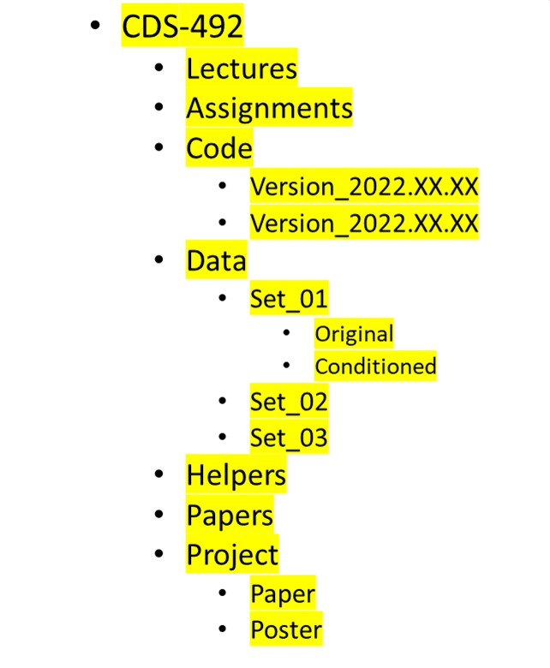
WK03 – Class Folder
Class Folder
Create a folder structure as shown in the picture
Put files in respective folders (e.g., papers, assignments, etc.)
Put the folder in Onedrive or Google Drive
Share the folder with the teacher (aslaman@gmu.edu)
Screenshot of created folder

Slide 4
WK03 – Workflow diagram

Slide 5
WK03 – Project Purpose and Questions
Project purpose and motivation
Examples to explain the motivation for the project topic
Benefit(s) of the project (benefits who and how)
Research questions
Revised title (if needed)

Slide 6
WK03 – Data
Size of the data (e.g., number of columns, number of rows, file size in MB)
Format
Data shown in rows
Parameters/factors displayed in each column and type

Slide 7
WK03 – Data
Table of statistics for numerical columns

Slide 8
WK03 – Data
Plots of parameters

